Slide 1
Shell Bootcamp 2024 3 Reflections for Week #2
Preeti Pallavi
Date : 30-Aug-2024

Slide 2

About Me
Be kind for everyone you meet is fighting a battle you know nothing about. There is only one life, strive to do your best and make your mark.

Slide 3

My learnings from this week!

Slide 4
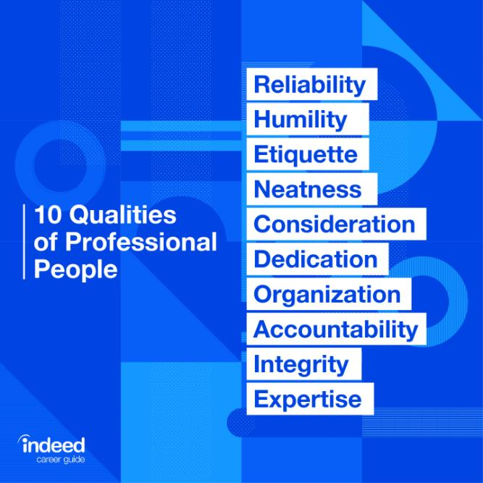
Learning 1 | My takeaways
Things we Learned in softskills (Day-1) are -
Interpersonal Relationship management
College to corporate transition
Plan, organize, write, edit, review for self assessment
Professional qualities
Self discipline

Slide 5
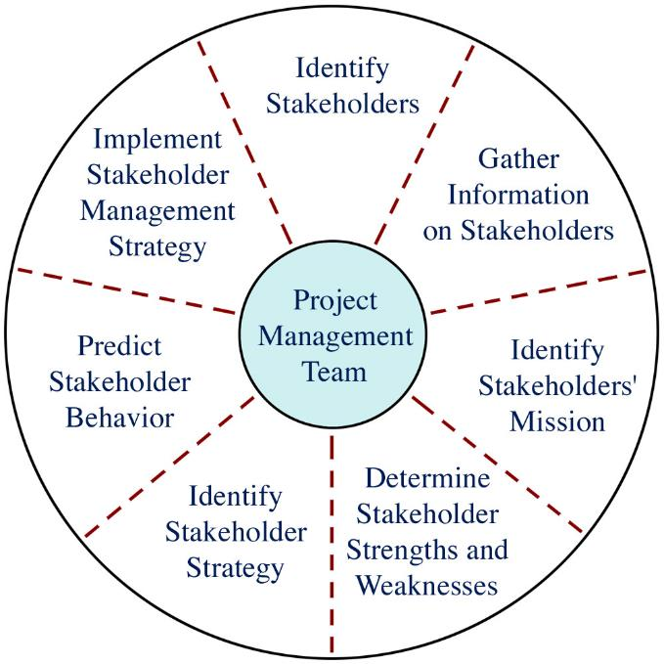
Learning 2 | My takeaways
Things we Learned in softskills (Day-2,3) are -
Good attitude and mindset
Mobile, meeting, email, group etiquettes
Stakeholder
Inform, monitor, satisfy, collab and manage closely
Stakeholder expectations
Team building
Collaboration with team
Dedication

Slide 6
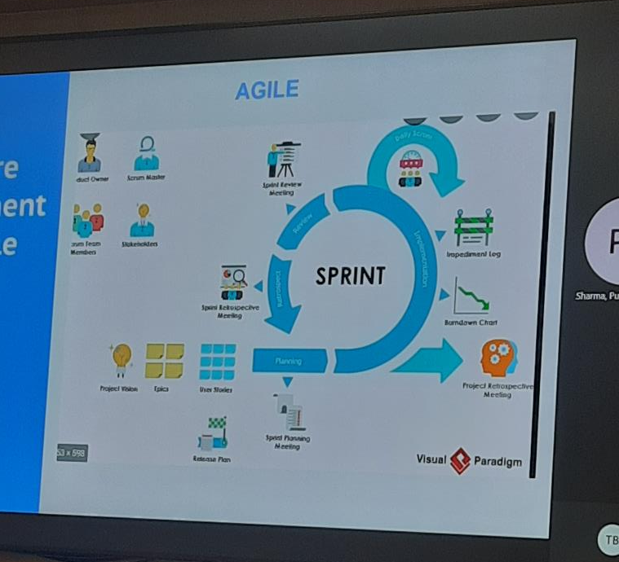
Learning 3 | My takeaways
Things we Learned in Technical (Day-4,5) are –
Introduction to Business Analytics (BA)
SDLC Model
Requirement Analysis
Requirement elicitation
Requirement modelling
Requirement management
Management Techniques
Types of model – Waterfall, V, Prototype, Agile
Scrum team, scrum ceremonies, scrum master

Slide 7

Relevance of learnings for my organization

Slide 8
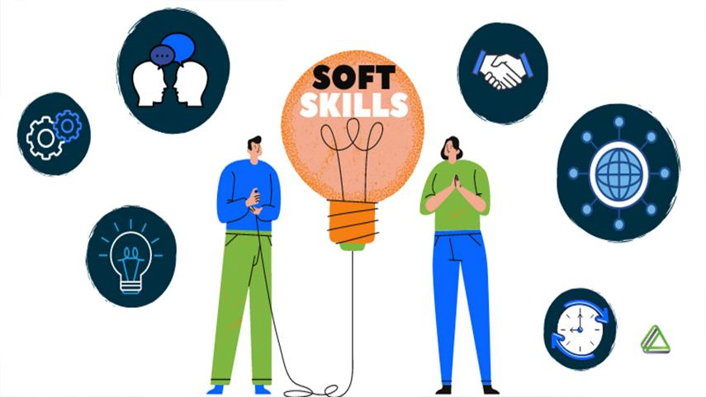
Learning 1 | Relevance for Shell
Soft skills, like organization, leadership, communication, and problem-solving, improve efficiency for the company and its employees specially in case for shell where networking along with technical skills is a huge requirement. They allow workers to become more productive and meet (and exceed!) standards and deadlines.

Slide 9
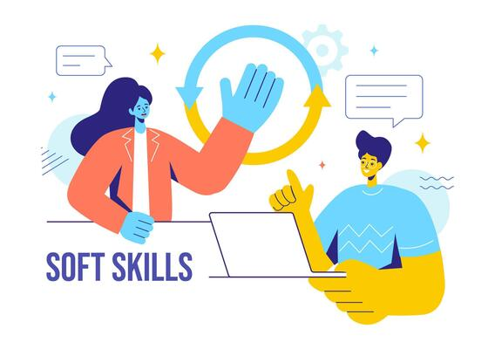
Learning 2 | Relevance for Shell
By facilitating effective communication, soft skills foster creative problem-solving and build a sense of professional camaraderie, which consequently increases productivity of our company. Without soft skills, teams and departments may struggle to function due to communication breakdown, conflict, and inefficacy.
[Add a graphic that provides view of how Shell implements this learning]

Slide 10

Learning 3 | Relevance for Shell
Business Analysis (BA) benefitted us in a lot many things with respect to shell. We now can-do informed decision making, greater revenue can be generated because of it, operational efficiency increases as there won’t be constant breaks once everything is decided in the most proper way possible. Iterative set of activities that help ensure that elicitation, documentation, refinement, and changes of requirements is adequately dealt with during a lifecycle. Reduces cost, improves quality, decreases time taken, decreases risks. Superior quality product, customer satisfaction, better control, improved project predictability, reduced risks, increased flexibility, continuous improvement are some benefits from AGILE.
[Add a graphic that provides view of how Shell implements this learning]

Slide 11

Challenges in implementing learning

Slide 12
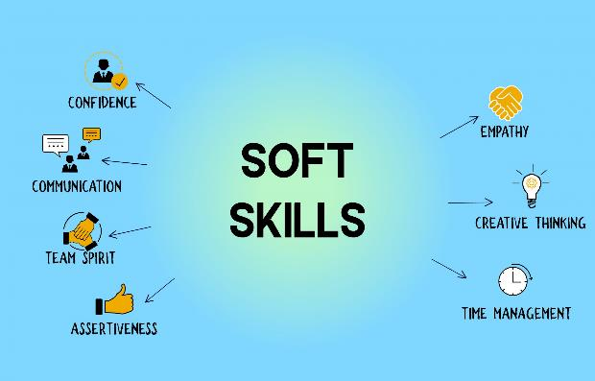
Challenge faced while implementing Learning 1
No challenges faced specially for the soft-skills class because every learning was depicted properly and moreover, we played skits and did role play to understand how things work. We might not have got best at it but did get good gist of it.

Slide 13

Challenge faced while implementing Learning 2
Teamwork could’ve been a little problem when arranged with certain people as they might be rigid and not so welcoming sometimes but that can also be overcome.

Slide 14

Challenge faced while implementing Learning 3
I was new to BA as I didn’t study that in my college, but facilitator taught it so well that it felt easy later. The sessions were great, very interesting. Implementation, software development and all other things might take a little time as we will become familiar with it slowly, but it will be worth it.

Slide 15

Action Plan

Slide 16
My Action Plan for this Week
Actions
Timeline
Status
Practicing communication skills, behavioural skills, BA & Agile, learn about scrum, Kanban, xp, etc
Saturday – Brush up concepts of softskills
Sunday – BA & Agile revision
Status of the same by the end of the week

Slide 17

Learning is also Fun!

Slide 18
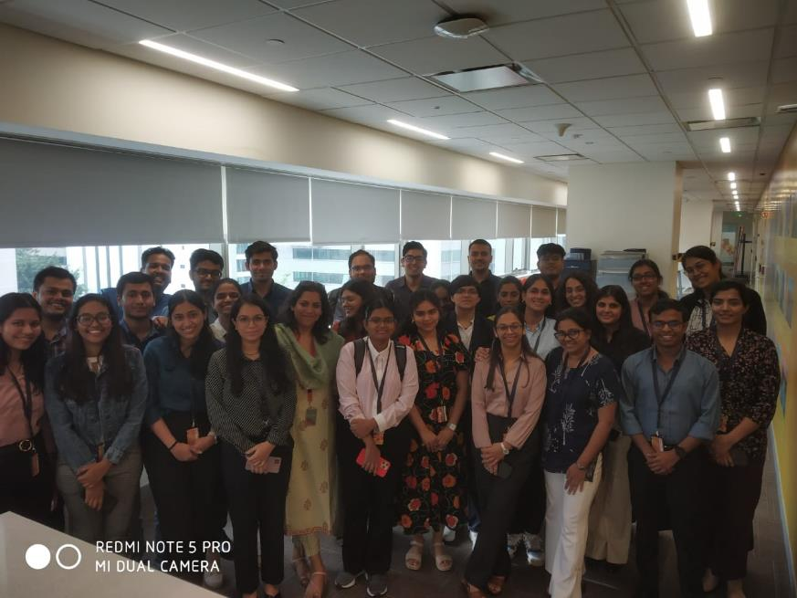
Learning is also Fun!
Nitya Ma’am is an amazing trainer. She was empathetic, she accepted us the way we are, she understood that every question can be subjective, so she said that no answers are right or wrong. She is a person of great knowledge enlightening us with years of experience she had through her case studies. Exciting, engaging, fun, with a lot of learning which made the sessions fun. Our technical ma’am was also great. She always tried to make class interesting coming up with jokes. Our technical sessions were the most fun!!

Slide 19

Summary
Learned softskills, BA & agile
Will revise DBMS learned from college
Software setup is needed.

Slide 20
Thank You

